Slide 1
Immunological arthropathies
Dr.S.A.F.Kurukulasuriya

Slide 2
Contents
What is arthritis
Classification of arthritis
Osteoarthritis
Rheumatoid arthritis
Psoriatic arthritis
Systemic lupus erythematoses

Slide 3
Arthritis is inflammation of one or more joints

Slide 4
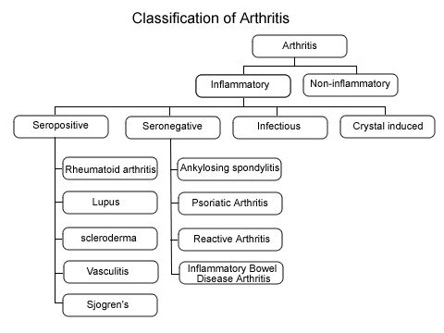

Slide 5
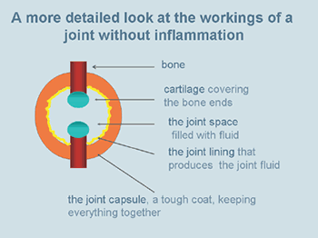

Slide 6
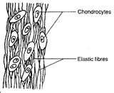
The normal cartilage
Matrix- Collagen fibers stuffed with proteoglycan molecules
The proteoglycan molecules attract water
Few chondrocytes scattered within the cartilage.

Slide 7
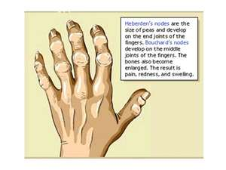
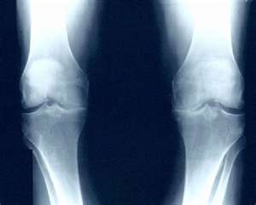
Osteoarthritis
The commonest chronic joint disease.
Primary generalized osteoarthritis-common in females, can affect multiple joints including inter phalangeal joints-nodal OA

Slide 8
Pathogenesis of osteoarthritis
Poorly understood.
Alterations in the metabolism of chondrocytes and the biochemistry of the cartilaginous matrix is well defined.

Slide 9
Pathogenesis OA contd…..
The chondrocyte starts the deterioration.It releases enzymes that degrade collagen and proteoglycans.
Breaks in the collagen fiber allow uptake of water.The cartilage swells and splits.
Crystals are released into the joint.This causes joint inflammation.

Slide 10
Rheumatoid arthritis
Common,chronic systemic inflammatory disease.
Association with HLA-DR4

Slide 11
Pathogenesis RA
RA is an immune mediated inflammatory disease (IMID).
Inflammatory reaction in the synovium produces destruction of the cartilage.
The earliest changes-
Microvascular injury
Oedema
Proliferation of mononuclear cells and lymphocytes

Slide 12
Pathogenesis of RA contd……
T cells(mainly CD4 positive) are activated by antigen presenting cells.
Lymphokines,lysosomal enzymes and prostaglandins are released.
Degeneration of cartilage and bone erosions result.
Rheumatoid factor is produced in the synovium.

Slide 13
Cytokines- IL1,IL6,TNF
Induction of cytokine synthesis
Upregulation of adhesion molecules
Activation of osteoclasts
Induction of other inflammatory mediators
Induction of the acute phase response (e.g. C-reactive protein, increased ESR)
Systemic features (e.g., fatigue, fever, cachexia)
Activation of B cells (IL-6)

Slide 14
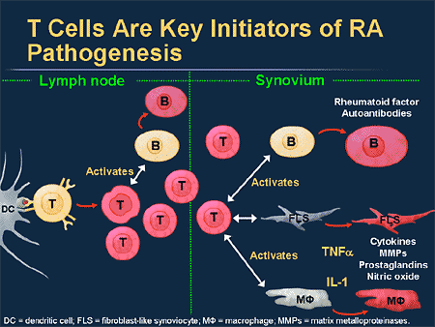

Slide 15
Pathogenesis of RA contd…..
Immune complexes are formed with the activation of complement.
Proliferating inflammatory tissue (pannus) leads to further damage of the joint.

Slide 16
T cell activation
Angiogenesis
B cell activation
Macrophage
activation
Plasma cells
Osteoclast
activation
Pannus
formation
Rheumatoid factor
Immune complexes
Bone
resorption
Collagenase
Stromelysin
Complement
activation
Cartilage
damage
Neutrophil
chemotaxis

Slide 17
Psoriatic arthritis
Pathogenesis is elusive
HLA B-27,-B7,-B17,B-13
Group A streptococci in guttate psoriasis

Slide 18
Systemic Lupus Erythematoses
Auto immune CTD.
Female:Male = 9:1
Commonly between 15-50 yrs.

Slide 19
Pathogenesis of SLE
Multifactorial
Prototypical AID
Environmental triggers-
UV light
Drugs
viruses

Slide 20
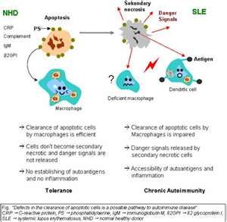
Pathogenesis of SLE contd…

Slide 21
Pathogenesis of SLE contd…
The env. triggers cause destruction of cells and expose
DNA, histones and proteins
The immune system produces antibodies against these
proteins
These antibody complexes cause destruction of blood vessels
Critical areas such as the glomeruli may be effected

Slide 22
Pathogenesis of SLE contd…
Chronic inflammatory disease
Type III hypersensitivity with type II involvement

Slide 23
Pathogenesis of SLE contd…
In health-apoptotic lymphocytes are removed in the germinal centres of lymph nodes by tangible body macrophages→ no free apoptotic material.
In SLE accumulation of apoptotic material is seen
These proteins(necrotic cells) act as auto antigens→autoimmunity

